Slide 1
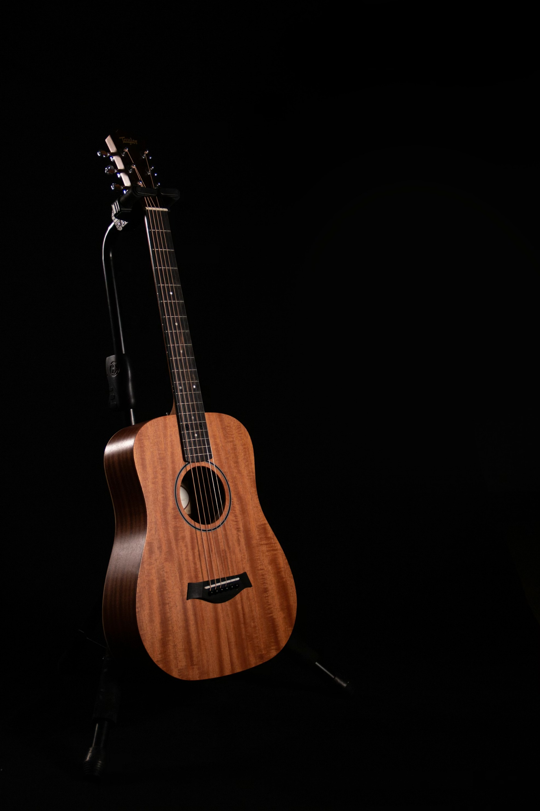
Musical Instruments Classification
ali Khaled 22P0260
Ahmad Sherif 2201075

Slide 2
Project Description
Image-Based classification of musical instruments
30 different instruments (30 classes)
Multiple Machine Learning models implemented

Slide 3

Dataset Overview
Dataset imported from Kaggle link: kaggle.com/musical-instruments-image-classification
No of Classes: 30
No of Images Loaded: 5093
80 / 20 Train Test Split

Slide 4
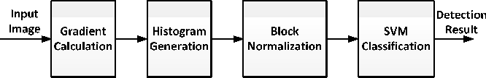
Preprocessing Pipeline
Resize images to 128x128
Convert to greyscale
Extract HOG features

Slide 5
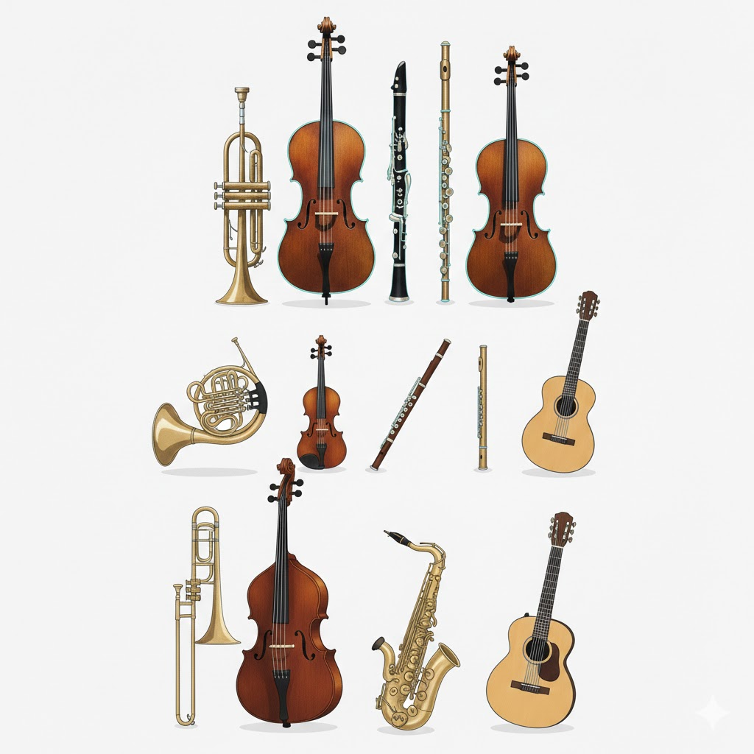
Feature Extraction
Extracted from grayscale images
Focuses on shape
The features extracted capture: Edge direction & strength Object contours & outlines Local shape patterns Texture-Like gradient structure

Slide 6
Classifiers Overview
Random Forest
Extra Trees
SVM
KNN
XGBoost

Slide 7
Random Forest
Ensemble of multiple decision trees
Each tree trained on random subsets of data and features
Final prediction by majority voting
Reduces overfitting compared to a single tree
Result:
Accuracy ≈ 47.5%

Slide 8
Extra Trees
Similar to Random Forest but with more randomness
Splits are chosen randomly instead of optimally
Faster training and stronger regularization
Reduces variance but may increase bias
Result:
Accuracy ≈ 50.2%

Slide 9
K-Nearest Neighbors (KNN)
Instance-based (lazy) learning algorithm
Classifies a sample using the majority vote of nearest neighbors
Distance metric: Euclidean distance
Sensitive to feature scaling and noise
Result:
Accuracy ≈ 49.9%

Slide 10
Support Vector Machine (SVM)
Finds an optimal hyperplane that separates classes
Maximizes margin between class boundaries
Uses kernel trick for non-linear separation
Effective in high-dimensional feature spaces
Result:
Accuracy ≈ 55.3%

Slide 11
XGBoost
Gradient boosting ensemble of decision trees
Trees are trained sequentially to correct previous errors
Uses regularization to prevent overfitting
Highly efficient and scalable
Result:
Accuracy ≈ 55.05

Slide 12
Conclusion
A complete image classification pipeline was implemented
Traditional classifiers were compared on the same feature set
SVM and XGBoost achieved the best performance, showing strong ability to handle high-dimensional HOG features
Tree-based ensemble methods showed moderate performance

Slide 13
Thank You
References: mathworks.com geeksforgeeks.org researchgate.net

